Slide 1


Numpy Array
List
vs

Slide 2
Reference
Youtube
Code

Slide 3


Numpy Array
List
vs

Slide 4
Numpy Array
List
vs

Slide 5
Numpy Array
List
vs
different dtype

Slide 6
Numpy Array
List
vs
different dtype
same dtype

Slide 7
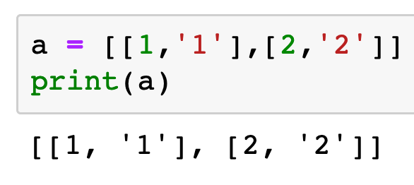
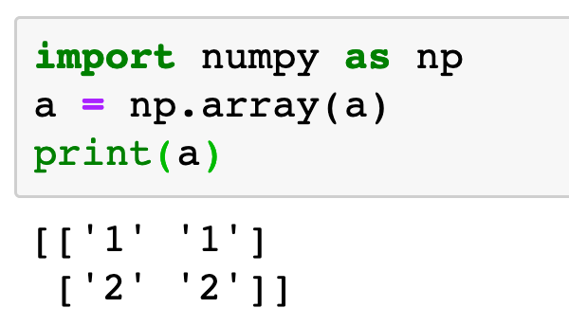
Numpy Array
List
vs
different dtype
same dtype

Slide 8
Numpy Array
List
vs
int
int
different dtype
same dtype

Slide 9
Numpy Array
List
vs
int
str
int
str
different dtype
same dtype

Slide 10
Numpy Array
List
vs
str
str
int
str
int
str
str
str
different dtype
same dtype

Slide 11
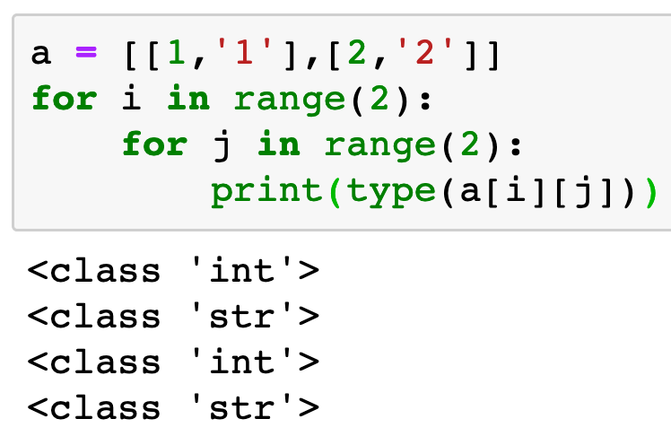
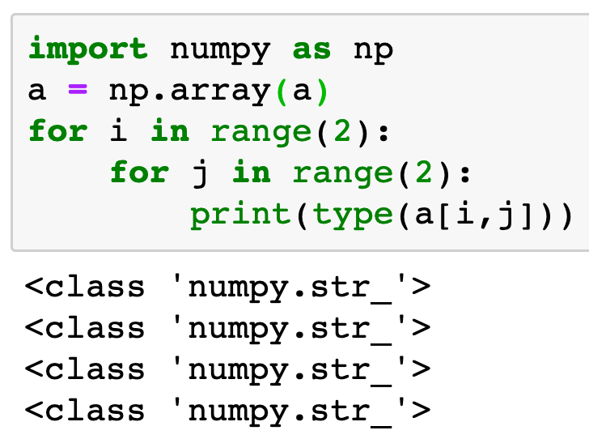
Numpy Array
List
vs
different dtype
same dtype

Slide 12
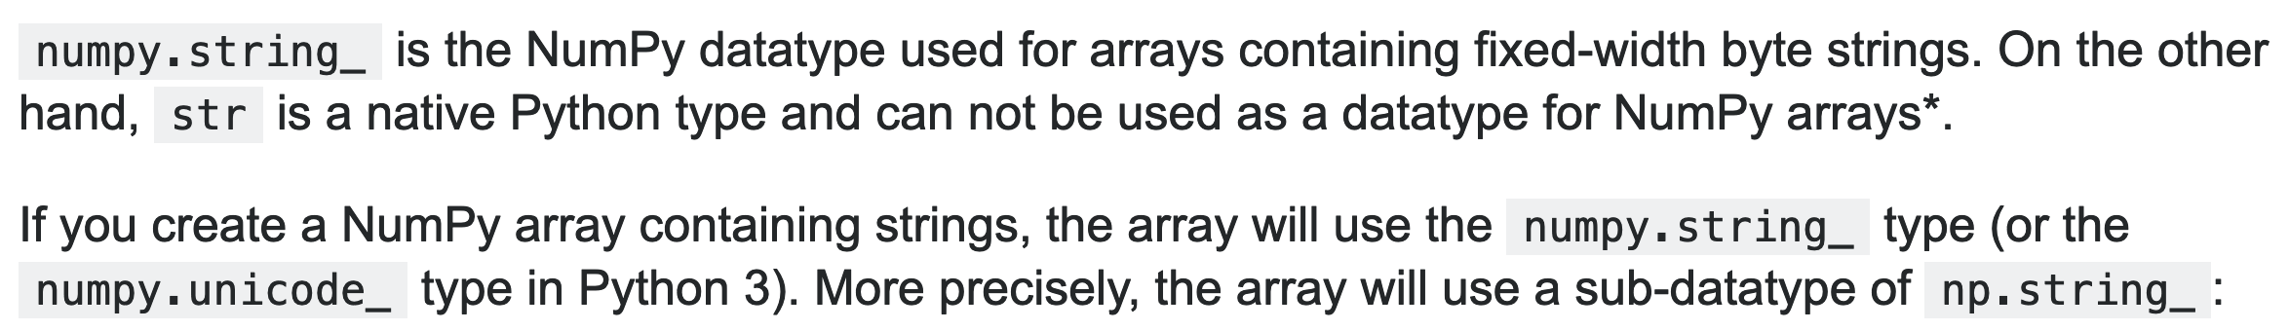
stackoverflow

Slide 13
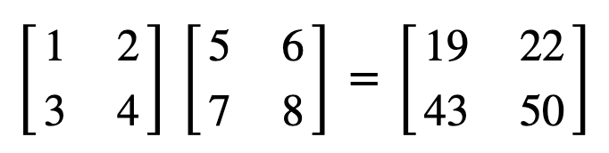

Slide 14
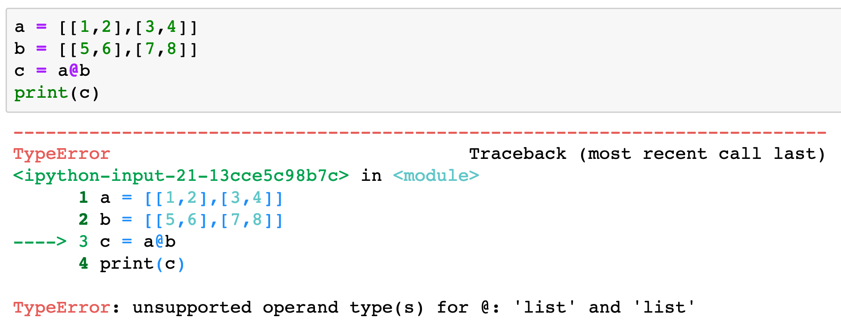

Slide 15
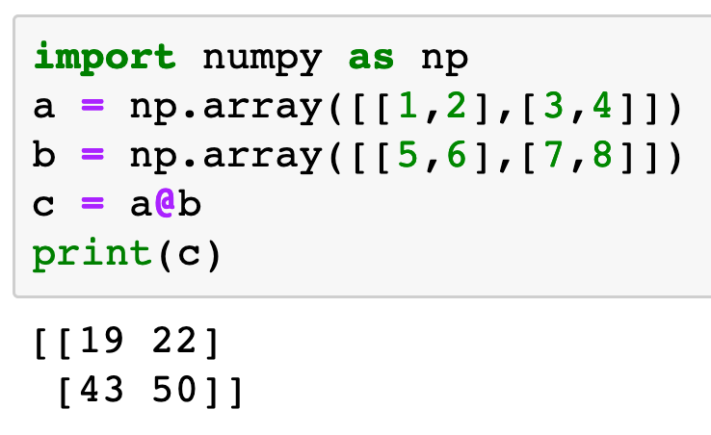

Slide 19
Now
Let’s Play with Code

